Slide 1

Cafe Table Reservation System Group-6

Slide 2

Team Members
1.Anchal Kumari
2.Dhanush M
3.Geddada Navya Teja
4.GokulaKrishnan Murugan
5.Pradeep Kumar N
6.Nashat Fatima
7.Prerana Mohapatra
8.Gyanenjay Rout
9.Nerella Shiva Theja

Slide 3

Contents
1.Introduction
2.Tools and Technologies
3.System Requirement
4.MicroService
5.Spring Cloud Config Server & Client
6.Spring Cloud Eureka Server & Client
7.Feign
8.Resilience4j-Circuit Breaker
9.Resilience-Retry
10.Services
11.Zipkin and Sleuth

Slide 4

Introduction
The Cafe Reservation System is a web application designed to make your cafe experience more convenient and enjoyable.
Whether you're a cafe owner or a customer, this system offers features that cater to your needs. Café administrators can manage their menus effortlessly, while customers can easily reserve tables, explore the menu, and connect with cafe staff.
Join us on this journey to create a modern cafe experience with user-friendly technology.

Slide 5






Tools And Technologies

Slide 6

System Requirement
The Basic System Requirements for Running this project are listed below:
Eclipse, Postman, MySQL and Docker are to be installed to the system
200MB of Free Space on Hard Disk.
Microsoft Windows 8,10,11 or Linux Equivalent OS.
Web Browser(Microsoft Edge, Google Chrome, Firefox).

Slide 7
Database:
MySQL
Server-side:
Spring Boot,Spring Boot JPA
DevOps:
Docker,Git Hub
Spring Cloud:
Spring Cloud Config,Spring Cloud Eureka,
Feign,Resilience4j,Retry,Sleuth and
Zipkin

Slide 8
Microservices
Microservices - also known as the microservice architecture - is an architectural style that structures an application as a collection of services.
Highly maintainable and testable
Loosely coupled
Independently deployable services
Organized around business capabilities
Owned by a small team

Slide 9
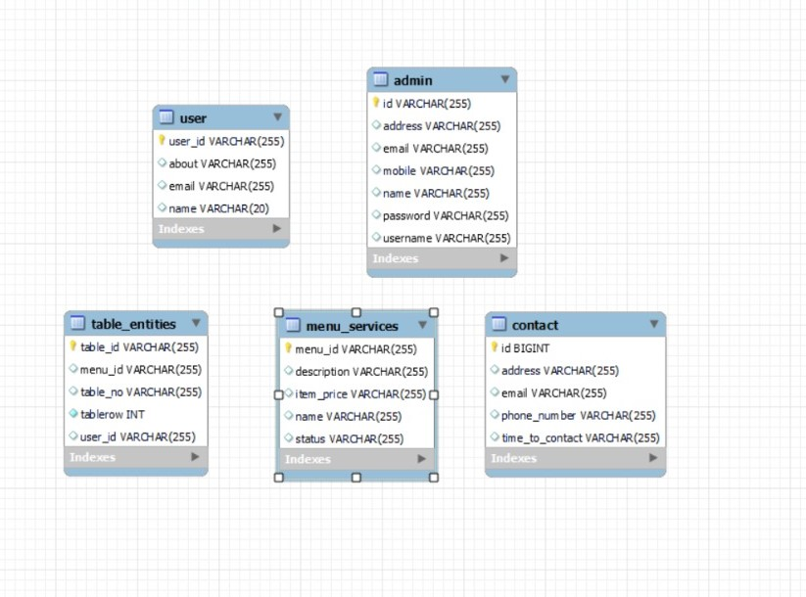
ER Diagram

Slide 10
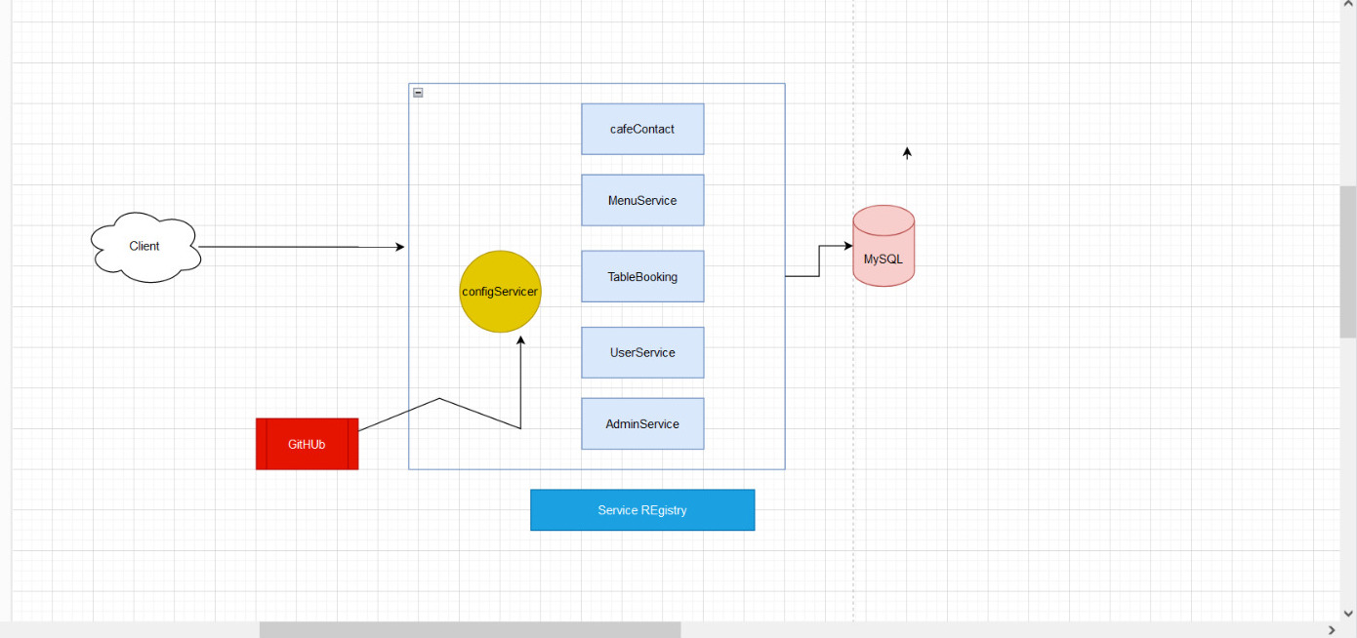
Connecting Config Server

Slide 11
Spring Cloud Config Server and Config Client
Config Server:
A Config Server is a centralized service that stores and manages configuration properties and settings for all the microservices in a distributed system. It acts as a configuration repository that stores configuration data in a structured format, typically using key-value pairs or YAML/JSON files.
Config Client:
A Config Client is a component within each microservice that connects to the Config Server to retrieve its configuration properties and settings. Each microservice acts as a client to the Config Server, requesting the configuration it needs during startup or runtime.

Slide 12
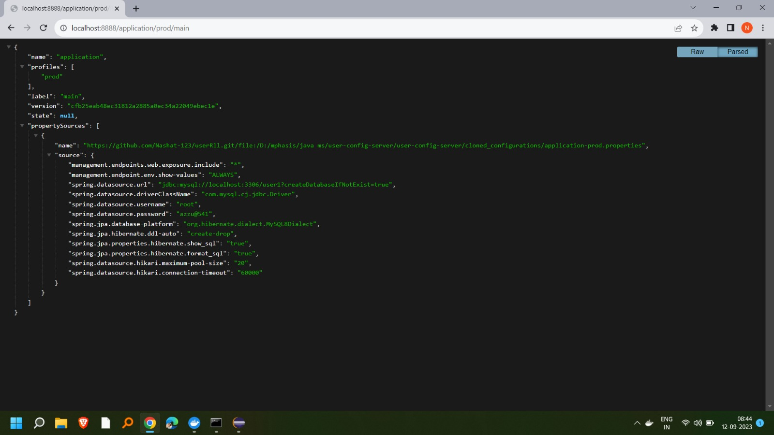
Config Server with Prod Profile

Slide 13
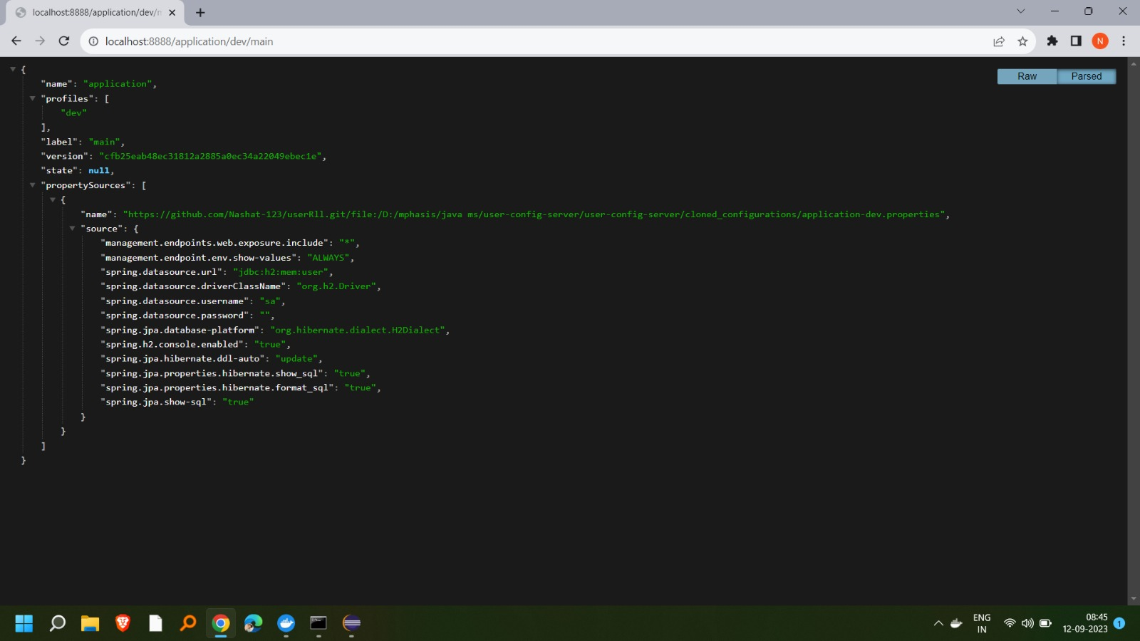
Config Server with Dev Profile

Slide 14
Spring Cloud Eureka server & client
Eureka Server:
Eureka Server is the central component responsible for managing and tracking the availability of microservices within a distributed system. It serves as the service registry where microservices register themselves upon startup and deregister when they shut down.
Eureka Client:
Eureka Client is a library integrated into each microservice that wants to participate in service registration and discovery.

Slide 15
Self-registration pattern in Eureka
The self-registration pattern in Eureka refers to the capability of a microservice to autonomously register itself with the Eureka server when it starts up, and to remove itself from the registry when it shuts down. This is a fundamental feature of Eureka that enables dynamic service discovery.
Here's how the self-registration pattern works in
Eureka:Service Startup:
When a microservice starts up, it contains a piece of client code (provided by the Eureka client library) that's responsible for registering the service with the Eureka server.The client sends an HTTP POST request to the Eureka server's registration endpoint, providing information about itself, such as service name, host, port, etc.
Service Registration:
The Eureka server receives the registration request and stores the information in its registry.The server now knows that a new instance of the service is available.
Service Discovery:
Other microservices that need to communicate with this newly registered service can query the Eureka server for information.The Eureka client library in those services allows them to make requests like "Give me the available instances of service X.“
Graceful Shutdown:
When a service instance is gracefully shut down, it can send a deregistration request to the Eureka server, informing it that it's going offline.

Slide 16
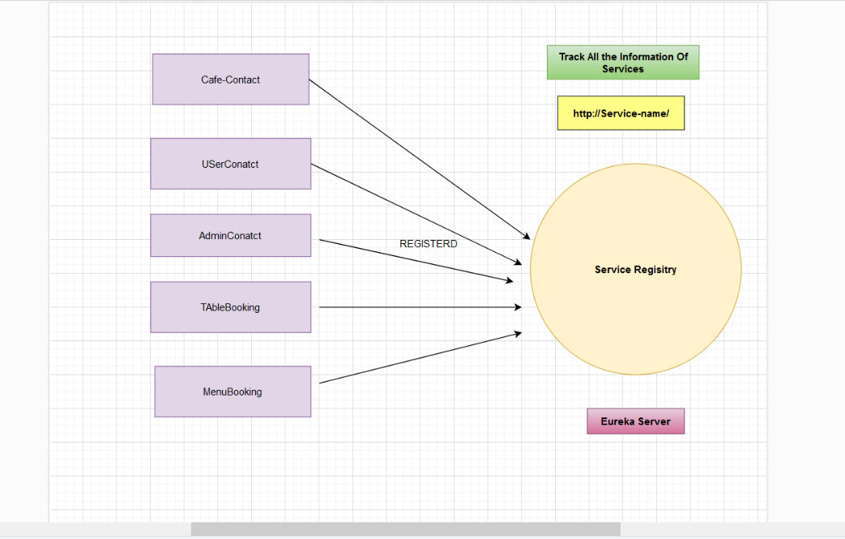
Registering With Eureka Server

Slide 17
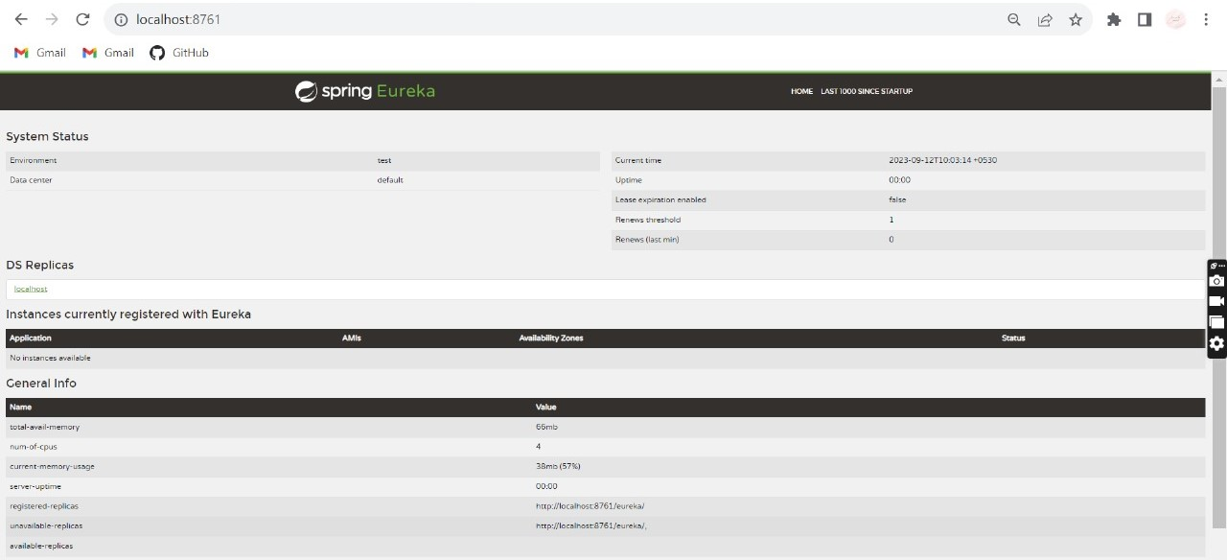
Eureka Before Resigtering Services

Slide 18
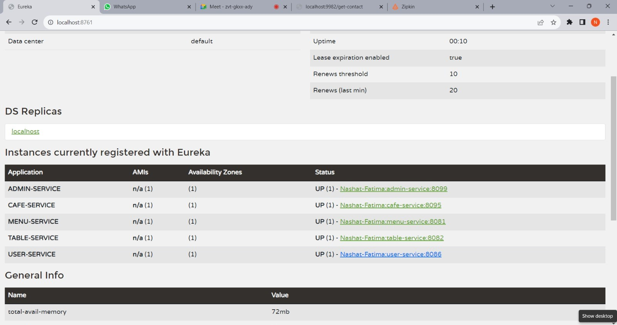
Eureka With Registered Services

Slide 19
Feign
Feign is a declarative web service client framework that simplifies the process of making HTTP requests to other services in a microservices architecture. It is part of the larger Spring Cloud ecosystem and is commonly used with Spring Boot applications.
Feign allows developers to write HTTP clients in a more straightforward and declarative manner, making it easier to interact with RESTful web services.

Slide 20
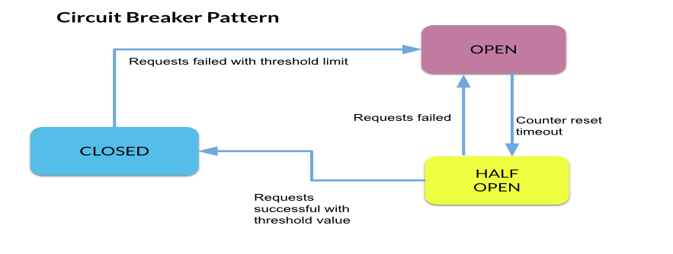
Resilience4j -Circuit Breaker
Resilience4j provides higher-order functions (decorators) to enhance any functional interface, lambda expression or method reference with a Circuit Breaker, Rate Limiter, Retry or Bulkhead

Slide 21
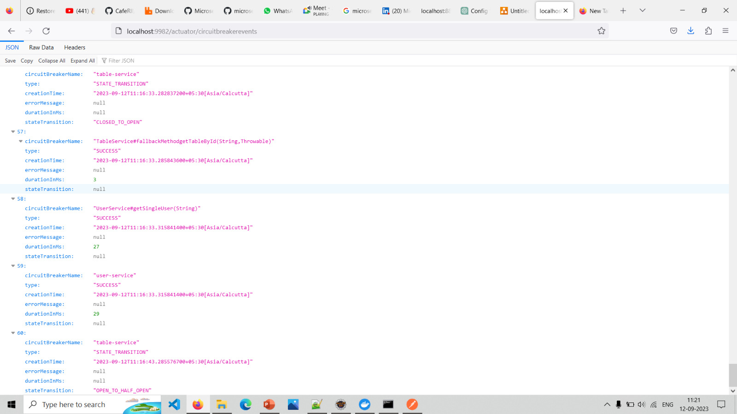
Circuit Breaker Events

Slide 22
Resilience4j - Retry
In Resilience4j, a retry event refers to the lifecycle events that occur during the execution of a decorated function when the retry mechanism is in action.

Slide 23
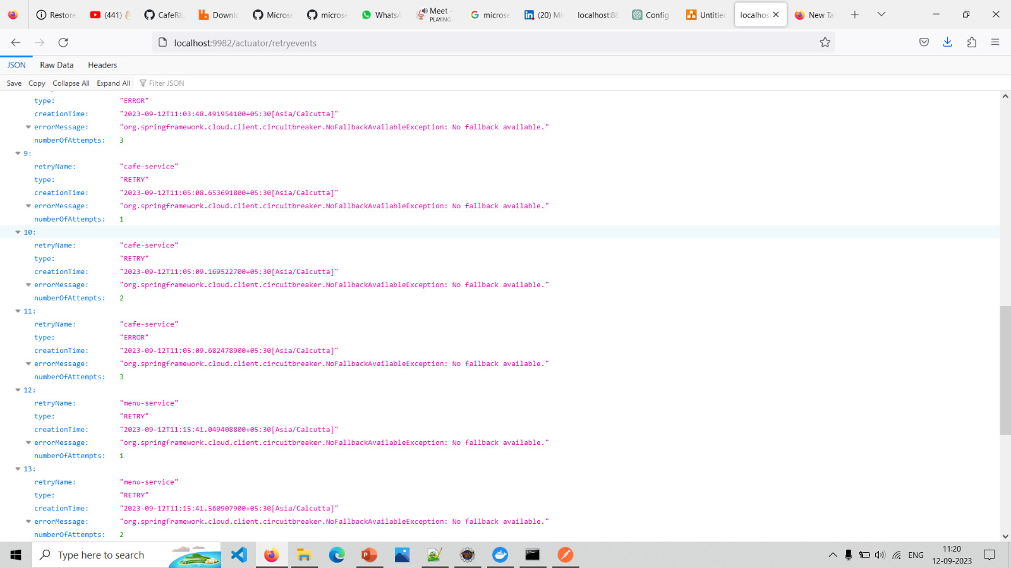
Retry Events

Slide 24
Services
Admin Service
User Service
Menu Service
Table Service
Cafe Contact

Slide 25
Admin Service
The Admin Service is a crucial component in our system, responsible for managing administrative users within our application ecosystem.
It provides essential functionalities for adding new administrators and viewing existing ones. This service plays a pivotal role in ensuring the security and integrity of our platform.
Add New Admins:
The Admin Service allows authorized users to add new administrators to the system. This functionality is vital for expanding our administrative team and granting appropriate privileges.
View Admin Details:
Administrators can retrieve comprehensive information about existing admins, including their names, contact details, roles, and other relevant attributes. This feature facilitates efficient management and oversight.

Slide 26
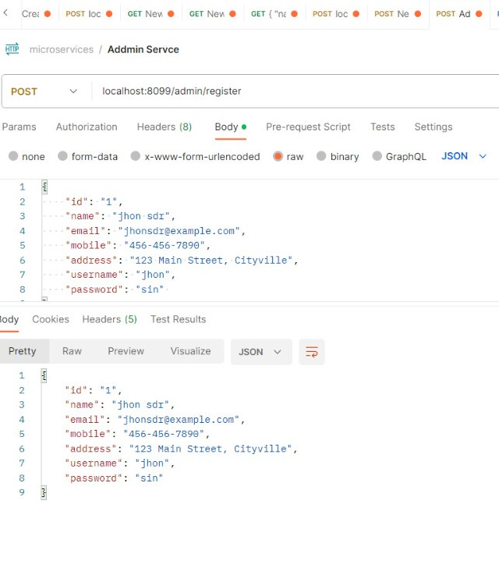
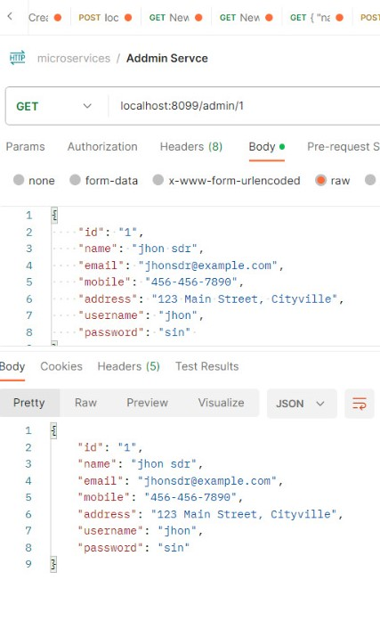
Admin Post and Get method

Slide 27
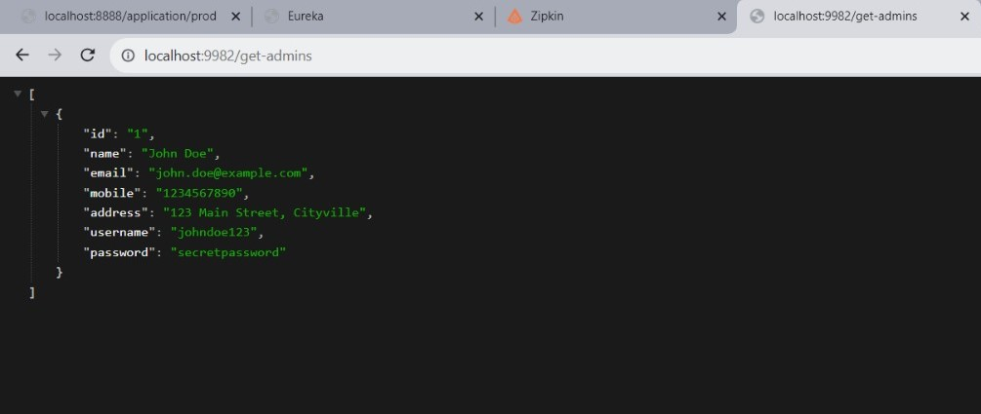
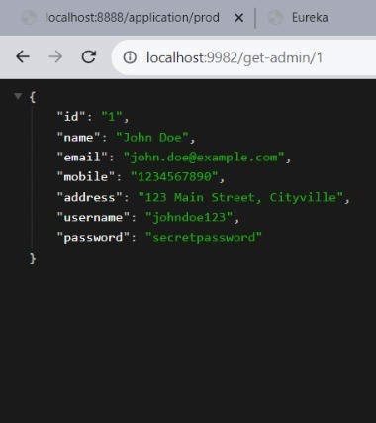
Getting Admins From the Admin Service Registered on Eureka By Using Feign Client

Slide 28
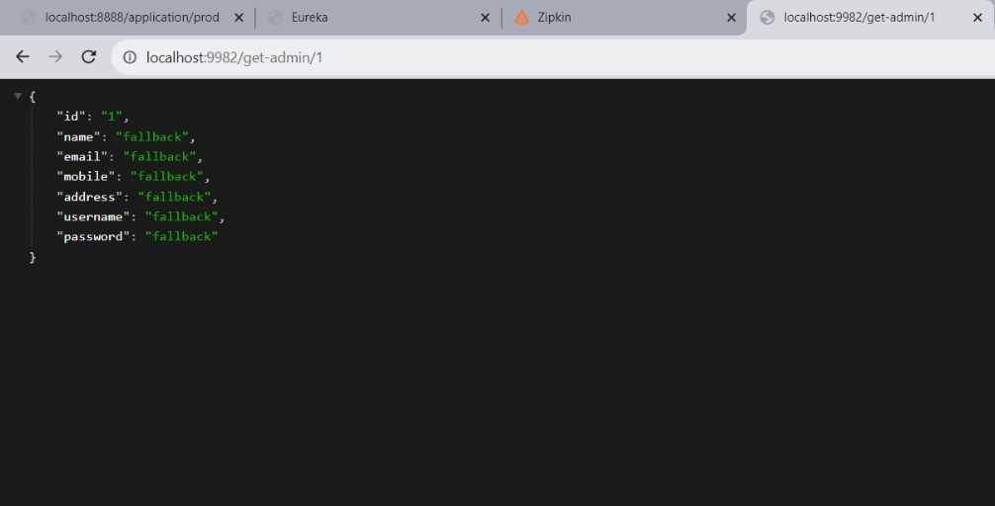
FallBack Method Exclusion When Admin Service is Down

Slide 29
User Service
The User Service is a vital component of our application ecosystem, responsible for managing user accounts and authentication. It provides essential functionalities for user registration, login, and retrieval of user information.
User Registration:
The User Service allows individuals to create new user accounts by providing essential information such as username, email address, and password. This functionality is fundamental for onboarding new users.
User Profile Retrieval:
Users can retrieve their profile information, including personal details,.
Integration with Eureka Registry:
The User Service seamlessly integrates with the Eureka service registry, allowing it to be discovered by other components within our microservices architecture.
Update User Information:
Authenticated users have the ability to update their account information, such as changing their password, email address, or other personal details.
Delete User Account:
admin can able delete the perticular account on the user request.

Slide 30
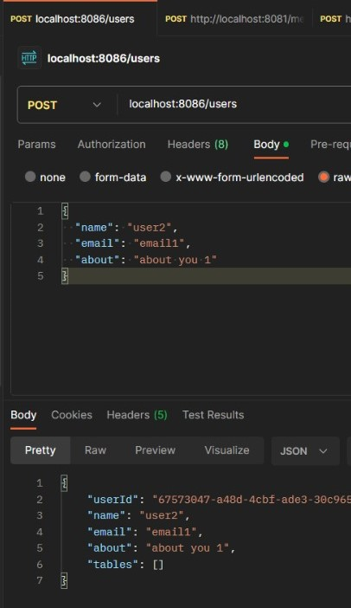
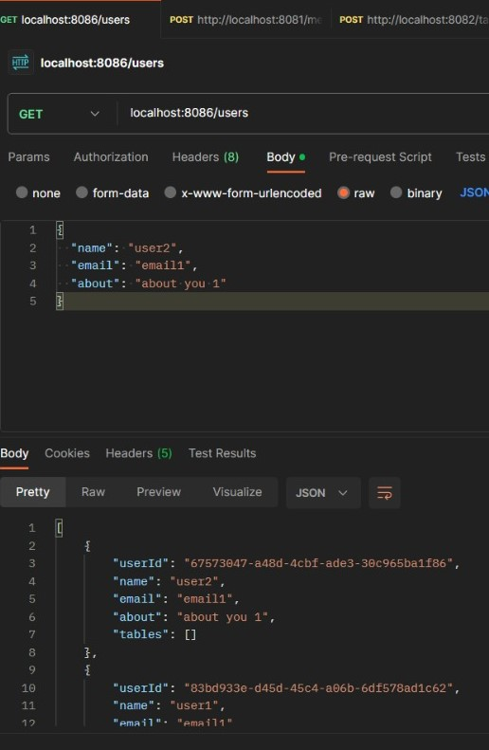
User Post and Get Method

Slide 31
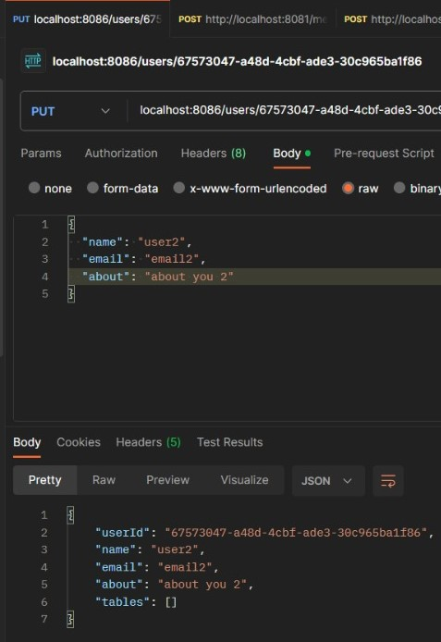
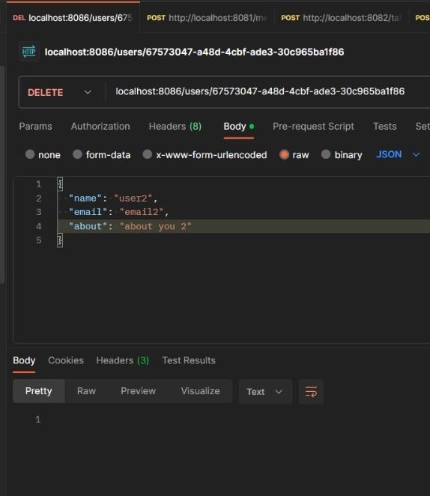
User Put and Delete Method

Slide 32
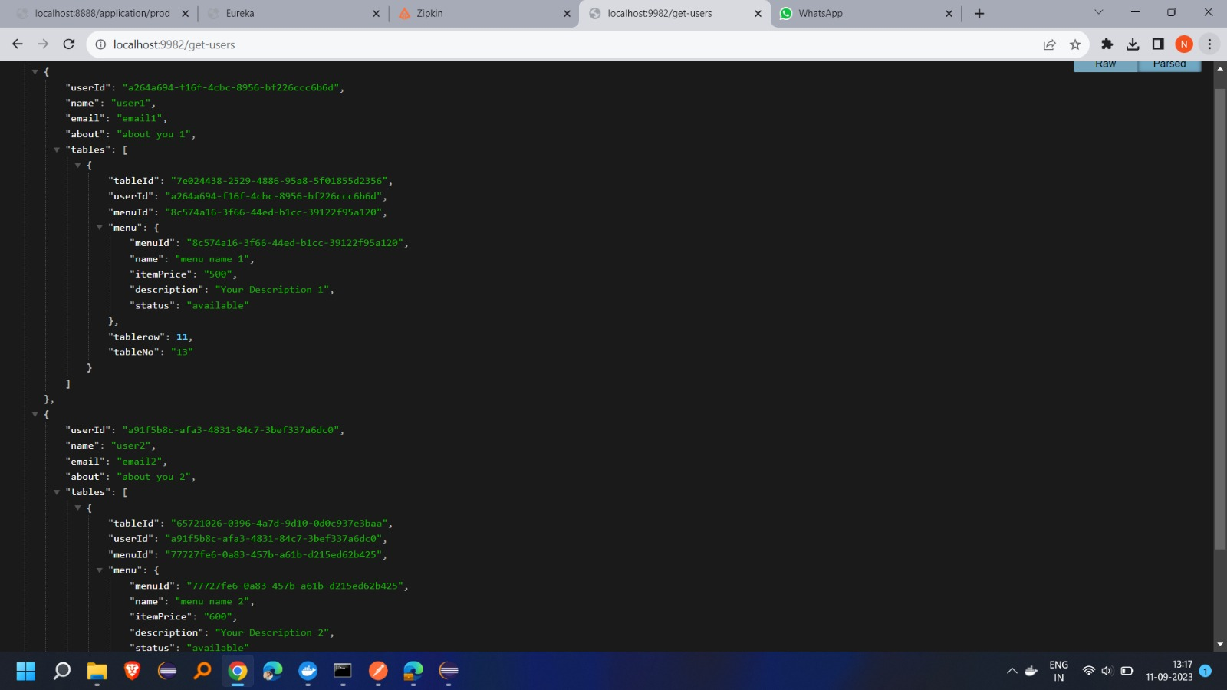
Getting All the User Data From the User,Menu,Table Services Registered on Eureka By using Service to Service Calls

Slide 33
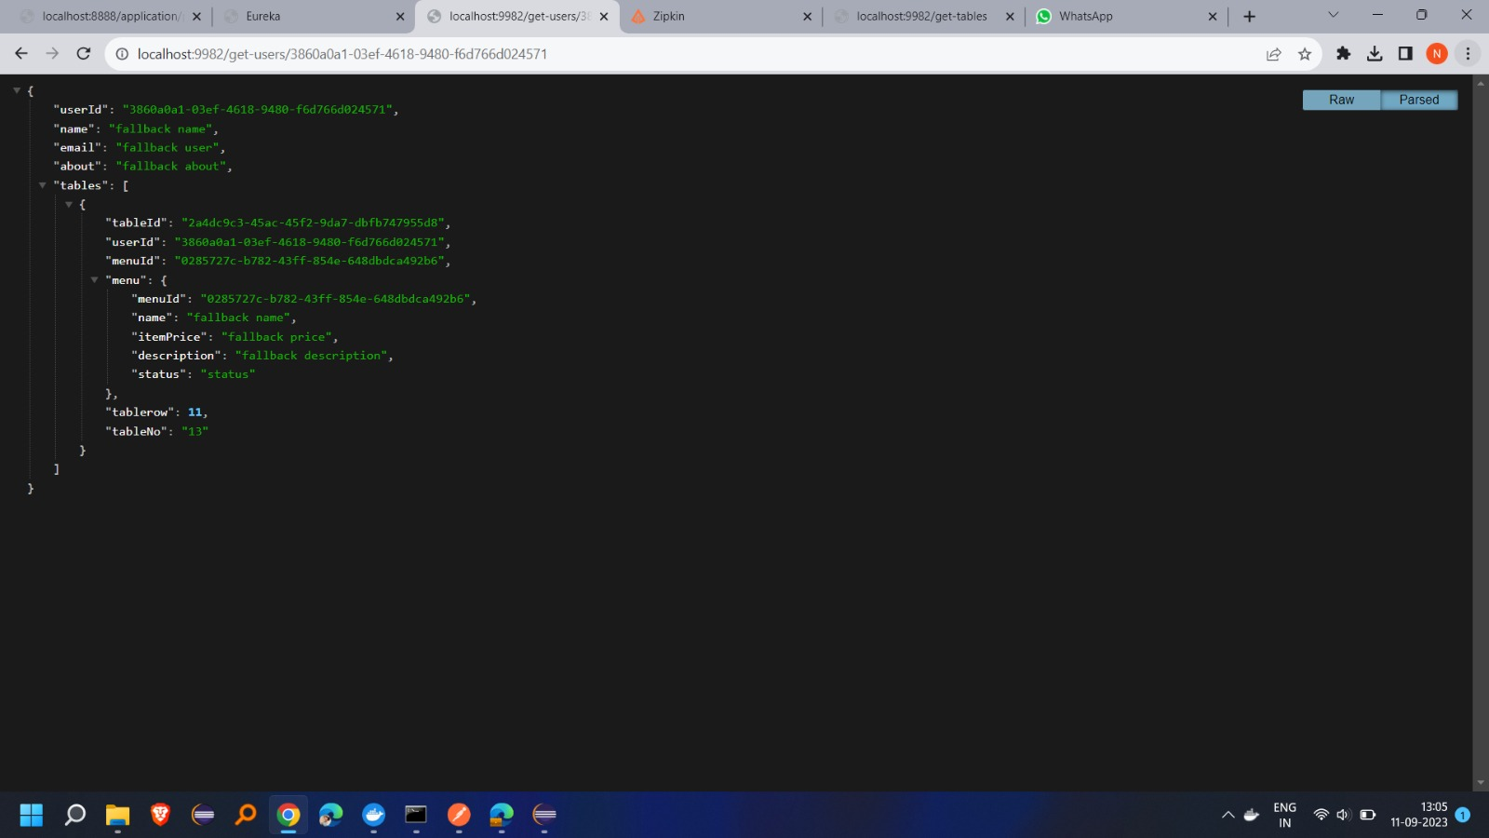
Getting User By Id From the User,Menu,Table Services Registered on Eureka By using Service to Service Calls

Slide 34
Fallback Method in User Service When Menu Service is Down

Slide 35
Menu Service
The Menu Service is responsible for managing menu items and their associated details. It provides a comprehensive set of functionalities including Create, Read, Update, and Delete (CRUD) operations for menus. This service is essential in ensuring a dynamic and up-to-date menu experience for our users.
Create Menu Items:
The Menu Service allows administrators to add new menu items, specifying attributes such as name, category, description, and price.
Retrieve Menu Items:
Users and administrators alike can retrieve a list of available menu items along with their relevant details. This enables customers to browse through the menu and make informed choices.
Update Menu Items:
Administrators have the capability to modify existing menu items, allowing for adjustments in attributes like name, category, description, and price
Delete Menu Items:
In instances where a menu item is no longer offered, administrators can initiate the removal of the item from the menu.

Slide 36
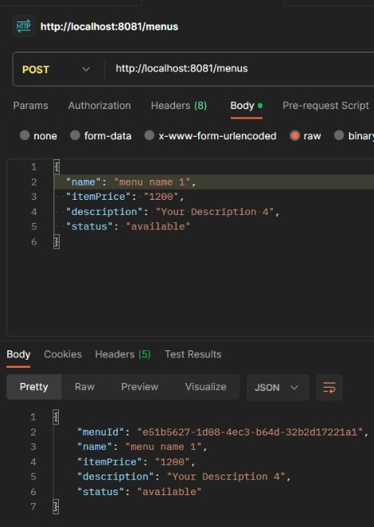
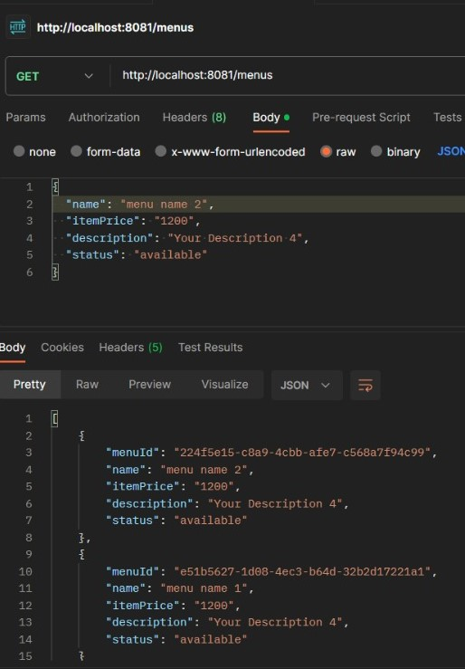
Menu Post and Get Method

Slide 37
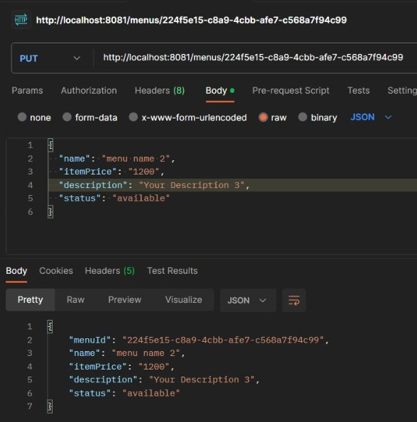
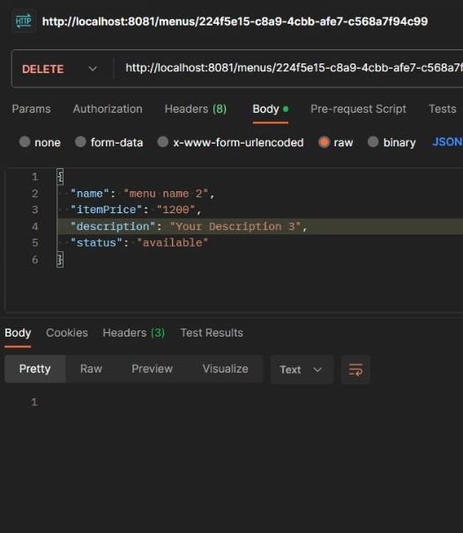
Menu Put and Delete Method

Slide 38
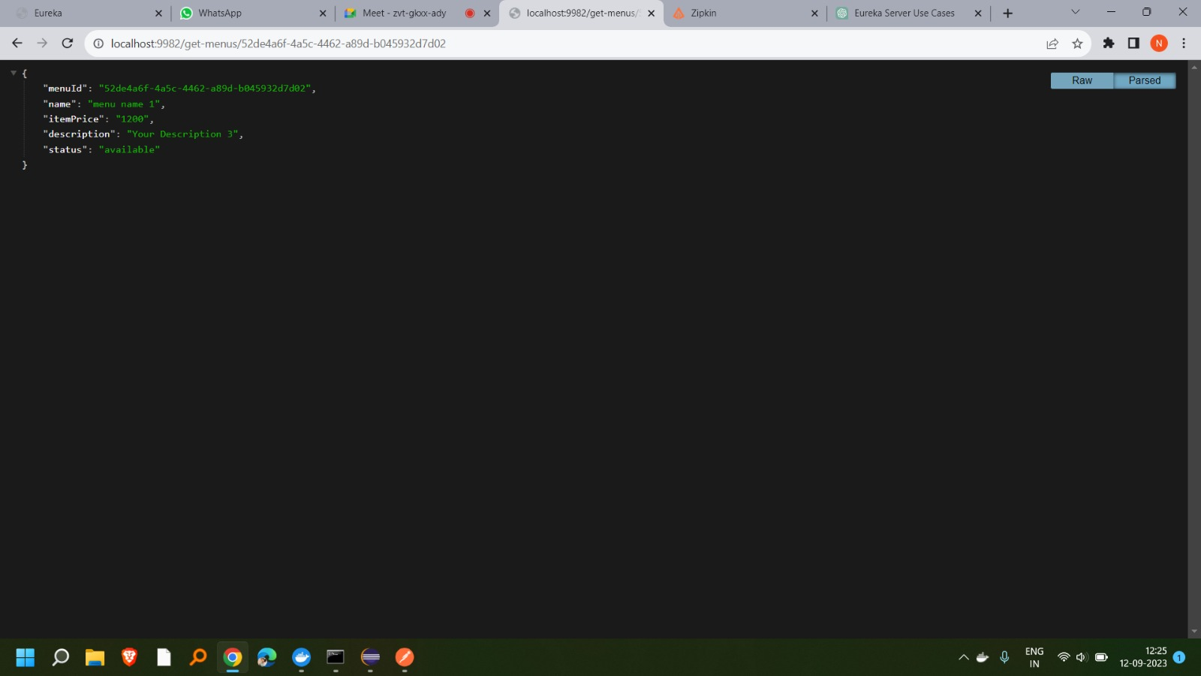
Getting Menu By Id From Menu Service

Slide 39
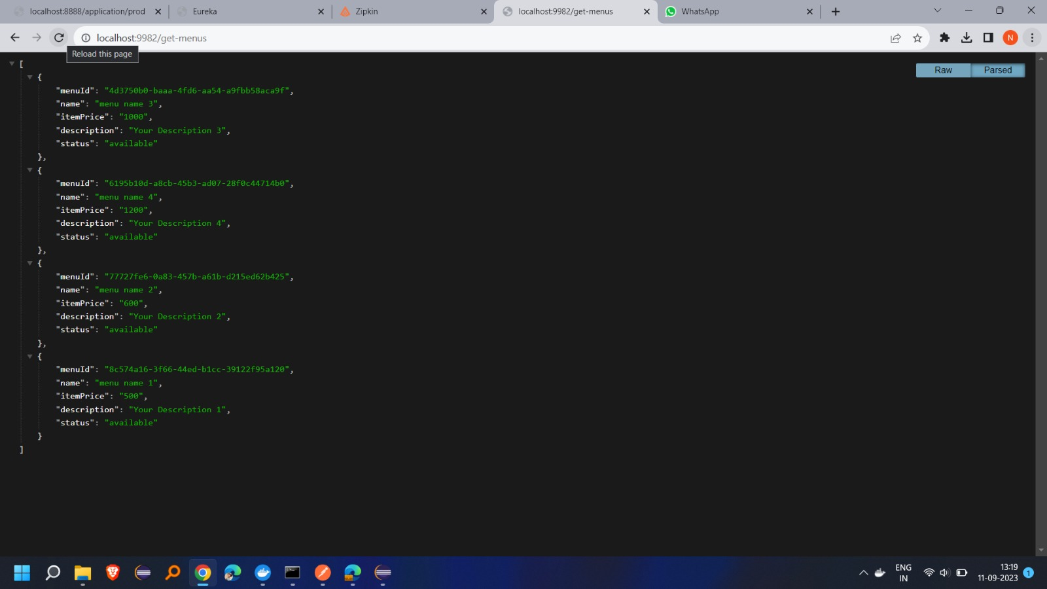
Getting all Menus From Menu Service

Slide 40
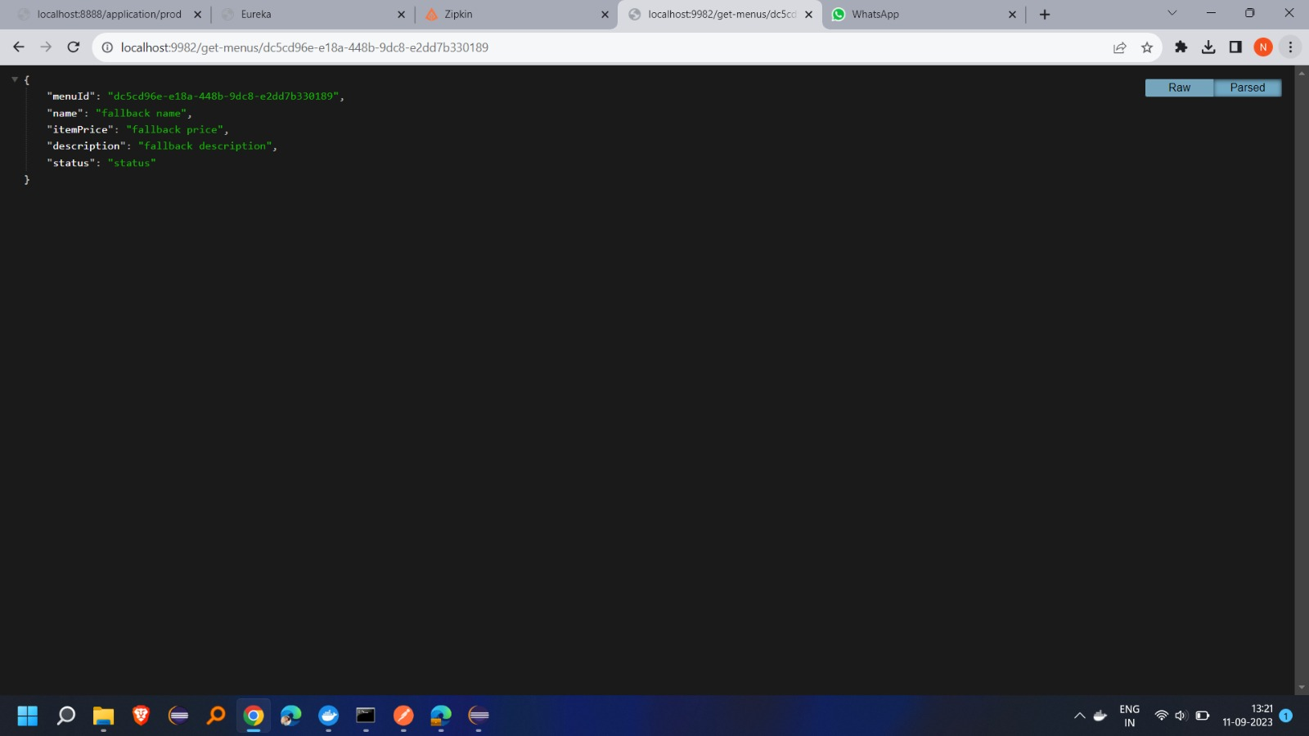
Fallback Method When Menu Service is Down

Slide 41
Table Service
The Table Service is a critical component of our application, facilitating the booking and management of tables within our establishment. It provides functionalities for users to view the list of available tables and make reservations based on their preferences.
View Available Tables:
The Table Service allows users to browse and view a list of available tables, along with details
Table Reservation:
Users can initiate the process of reserving a table
Tegration with Eureka Registry:
The Table Service seamlessly integrates with the Eureka service registry, allowing it to be discovered by other components within our microservices architecture.

Slide 42
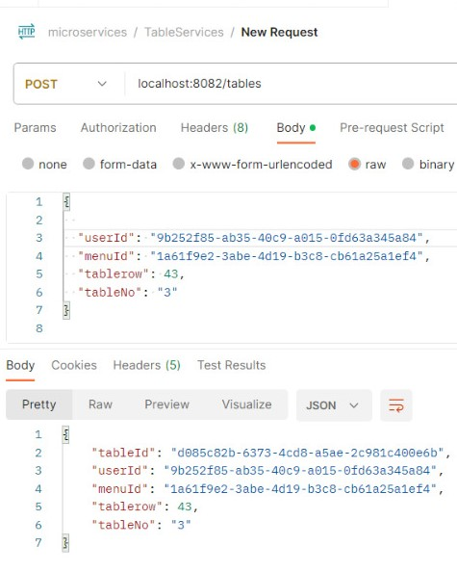
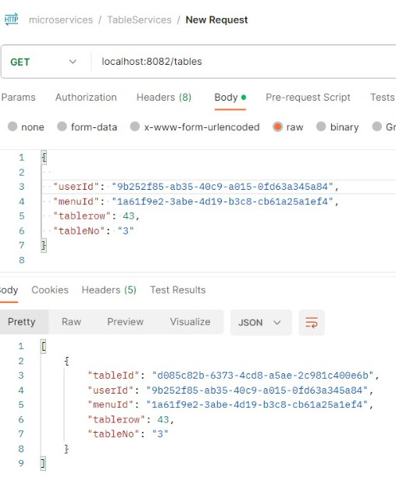
Table Post and Get Method

Slide 43
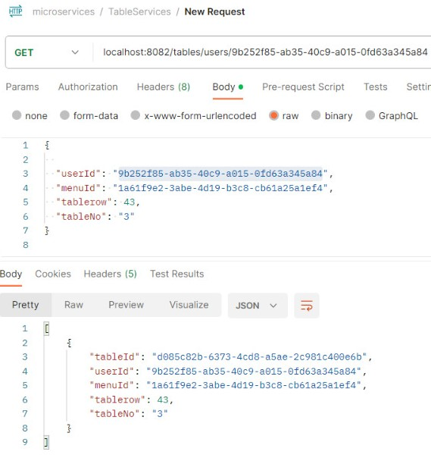
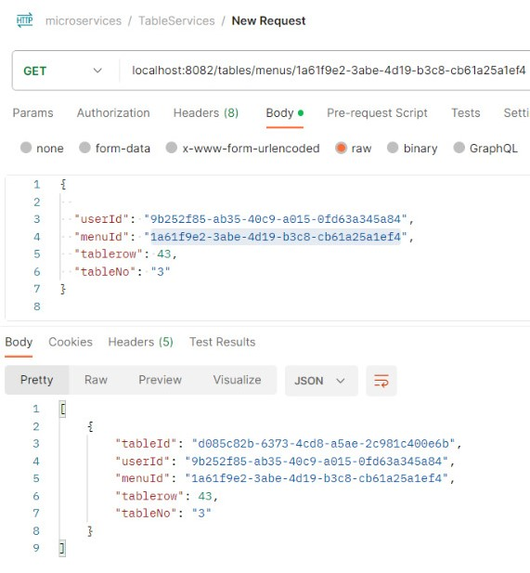
Table Get by user id and Get by menu id

Slide 44
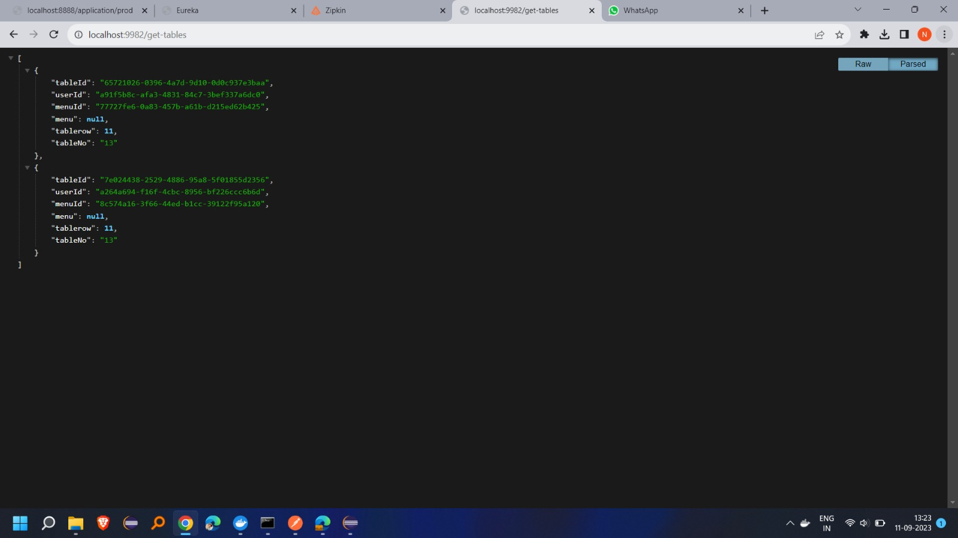
Getting Tables From Table Service Registered on Eureka

Slide 45
Cafe Contact
The Cafe Contact Service is a pivotal component of our application, responsible for managing and providing access to the contact details of our cafe. It serves as the primary point of contact between our cafe and our valued customers. This service allows users to retrieve the cafe's contact information and enables administrators to update it when necessary.
Retrieve Cafe Contact Details:
The Cafe Contact Service allows users to access essential contact information for our cafe
Update Cafe Contact Details:
Administrators have the authority to update the cafe's contact information in response to changes in contact methods or other relevant updates.
Integration with Eureka Server:
The Cafe Contact Service leverages the Eureka service registry for seamless service discovery within our microservices architecture.

Slide 46
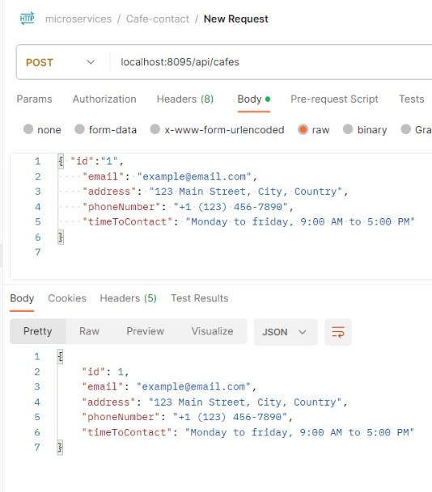
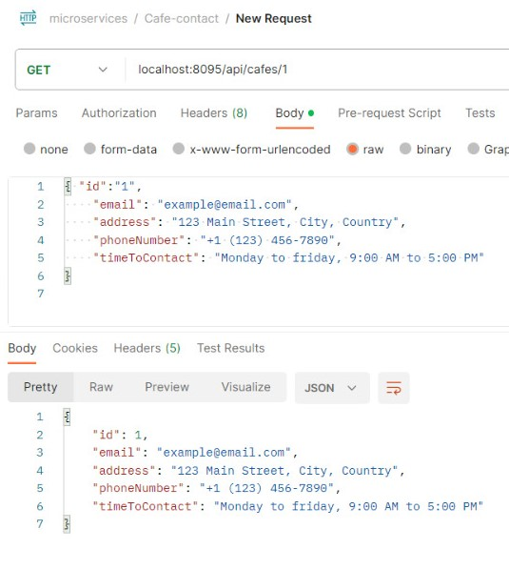
Café Post and Get Method

Slide 47
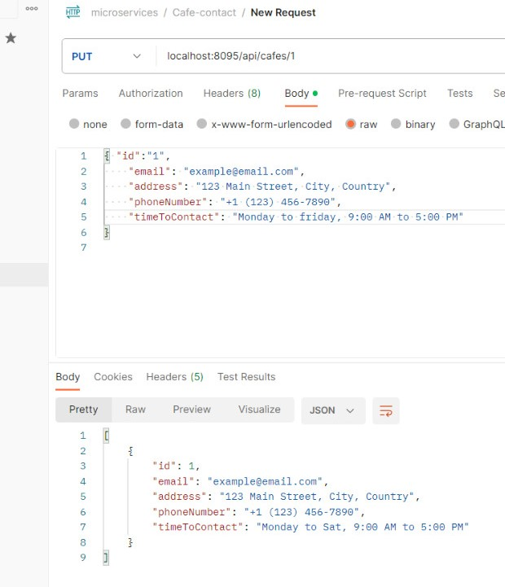
Café Put Method

Slide 48
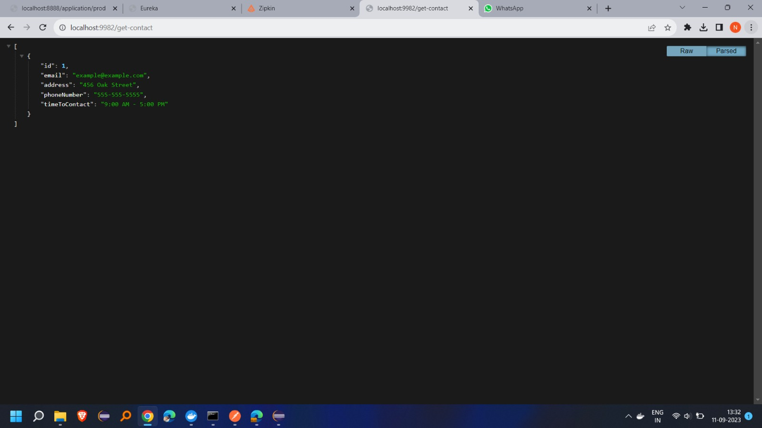
Getting Café Contact from Café Contact Service

Slide 49
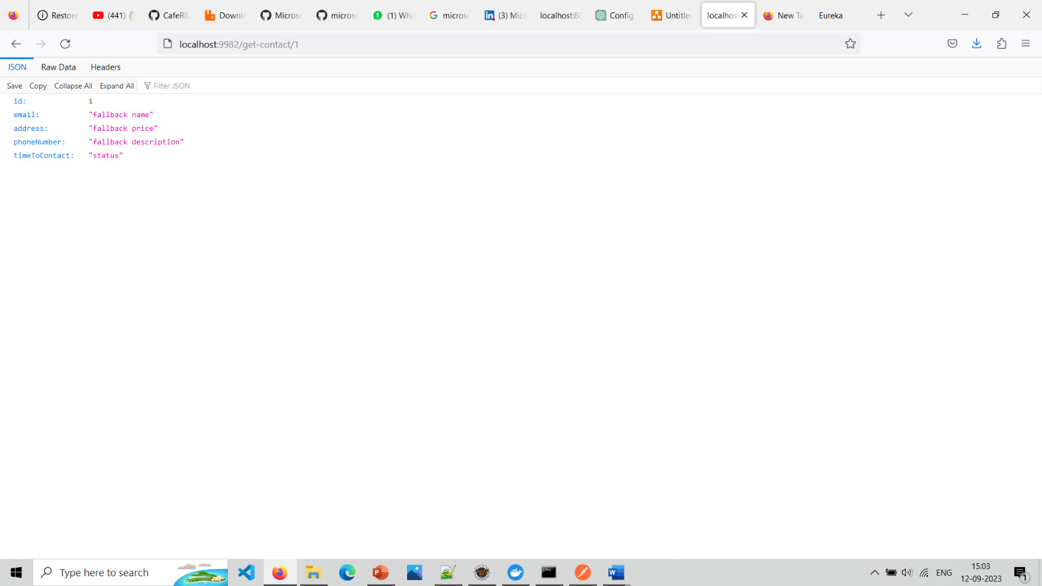
Fallback Method For Getting Café Contact By Id

Slide 50
Zipkin And Sleuth
Zipkin is a very efficient tool for distributed tracing in the microservices ecosystem.
“docker run -d -p 9411:9411 openzipkin/zipkin”
Sleuth is another tool from the Spring cloud family. It is used to generate the trace id, span idand add this information to the service calls in the headers

Slide 51
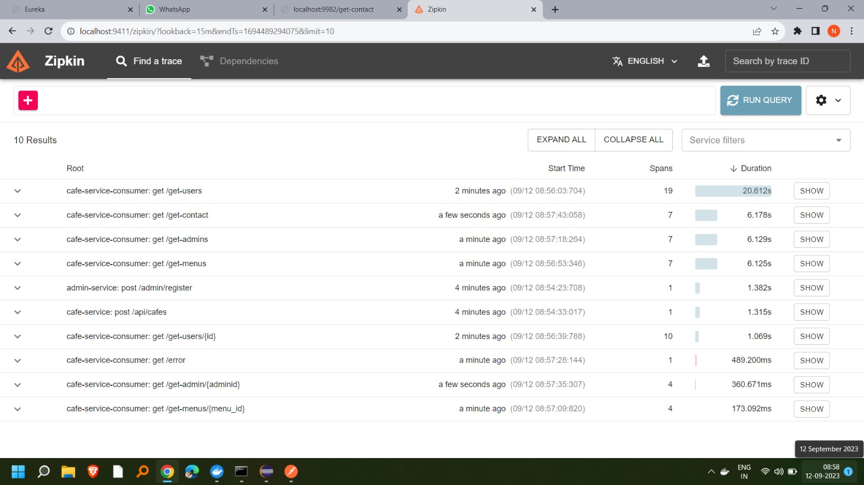
Zipkin Dashboard

Slide 52
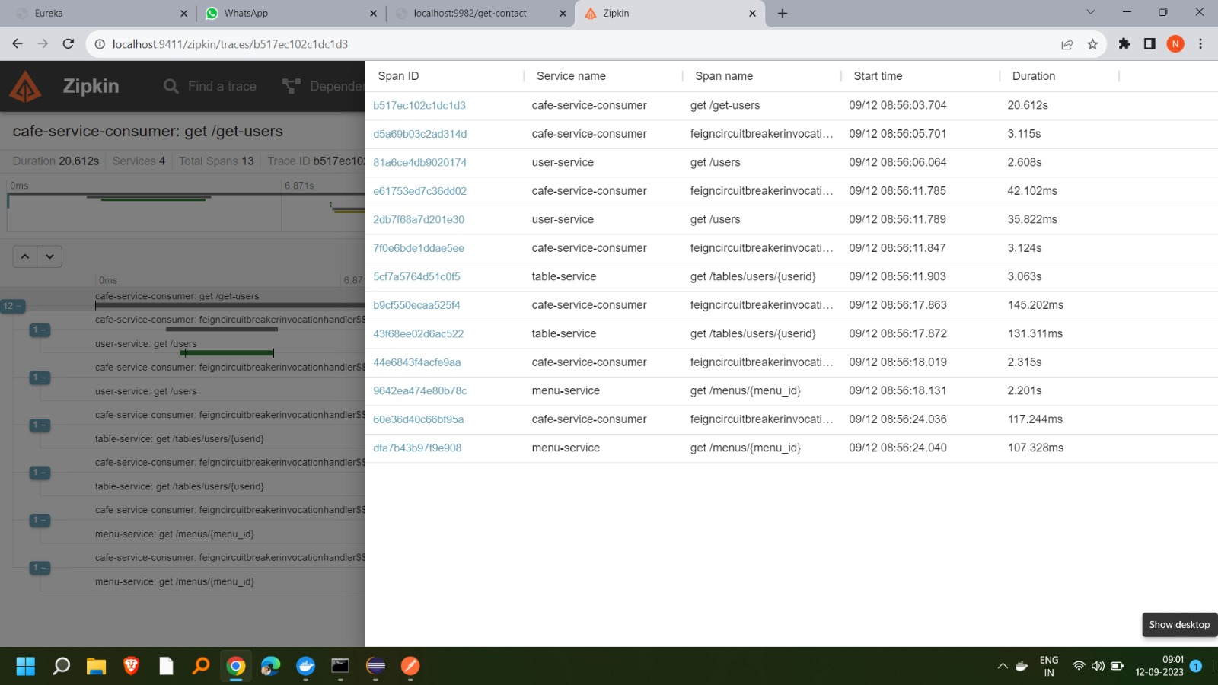
Zipkin Span Table

Slide 53


